Slide 1
Monitoring and Tuning Azure SQL Database
Module 5

Slide 3
Learning Units covered in this Module
Lesson 1: Monitoring and Troubleshooting Azure SQL Database
Lesson 2: Monitoring Query Performance using Query Performance Insight
Lesson 3: Azure SQL Database Tuning using Automatic Tuning
Lesson 4: Monitoring Azure SQL Database Performance using Intelligent Insights
Lesson 5: Monitoring Azure SQL Database Performance using Extended Events
Lesson 6: Configure Alerts through Azure Portal
Notes:
There are six lessons in this module.

Slide 4
Lesson 1: Monitoring and Troubleshooting Azure SQL Database
Notes:
This lesson covers Monitoring and Troubleshooting Azure SQL Database.

Slide 5

Objectives
After completing this learning, you will be able to:
Know the various options to monitor and troubleshoot the Azure SQL Database.
Notes:
This lesson covers Monitoring and Troubleshooting Azure SQL Database.

Slide 6
Common Issues on Azure SQL Database
Monitoring for Azure SQL Database is scoped at database level.
Here is list of most faced issues:
Database Connectivity
High DTU Percentage
Query Timeouts
Deadlocks
Database Storage consumption
Slow Queries

Slide 7
Tools to Monitor & Troubleshoot Issues
Query Performance Insight
Automatic Tuning
Intelligent Insights
Extended Events
Dynamic Management Views (DMVs)
Azure Database Portal Dashboard

Slide 8

Questions?

Slide 9
Lesson 2: Monitoring Query Performance using Query Performance Insight
Notes:
This lesson covers Monitoring Query Performance using Query Performance Insight

Slide 10
Objectives
After completing this learning, you will be able to:
Know how to troubleshoot the performance of your queries by using Query Performance Insight.
Notes:
This lesson covers Monitoring Query Performance using Query Performance Insight

Slide 11
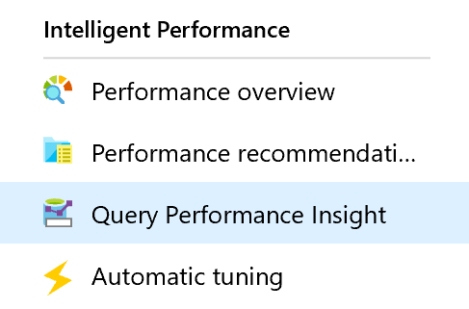
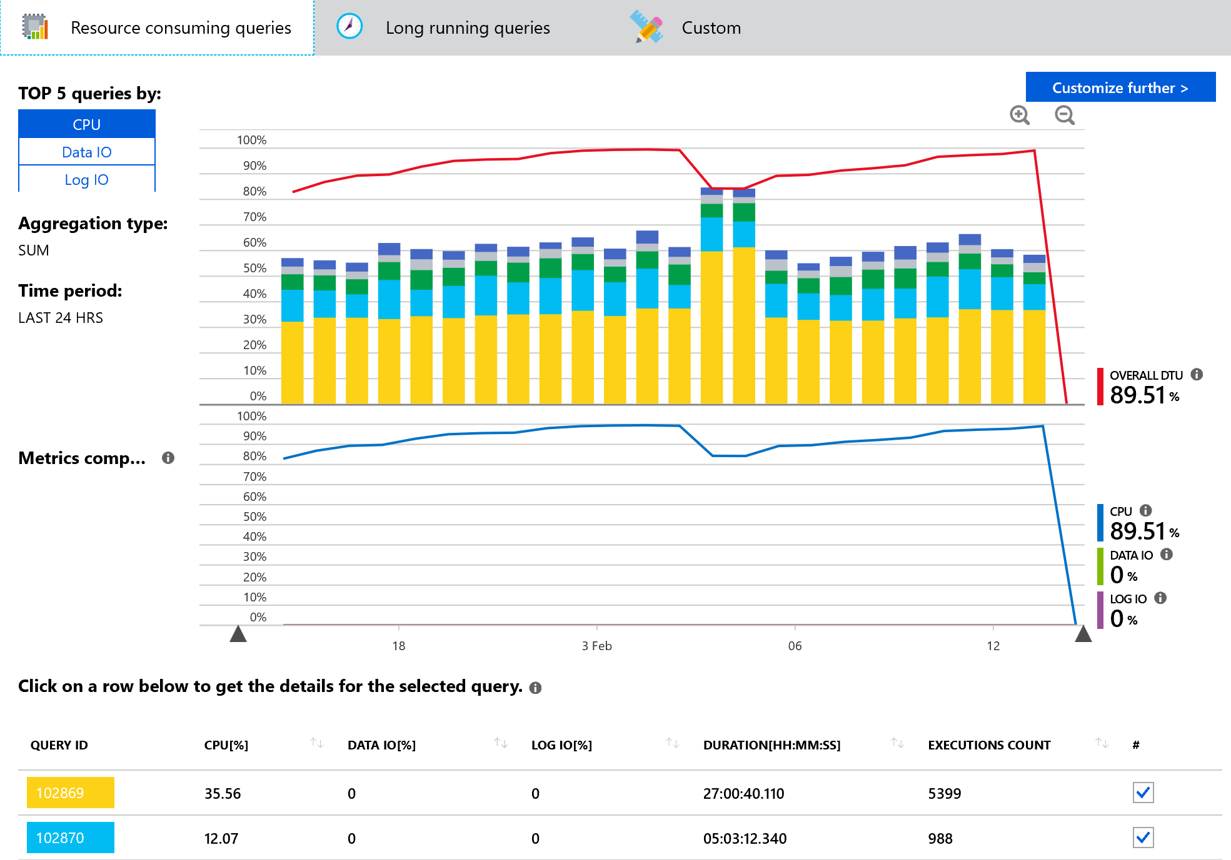
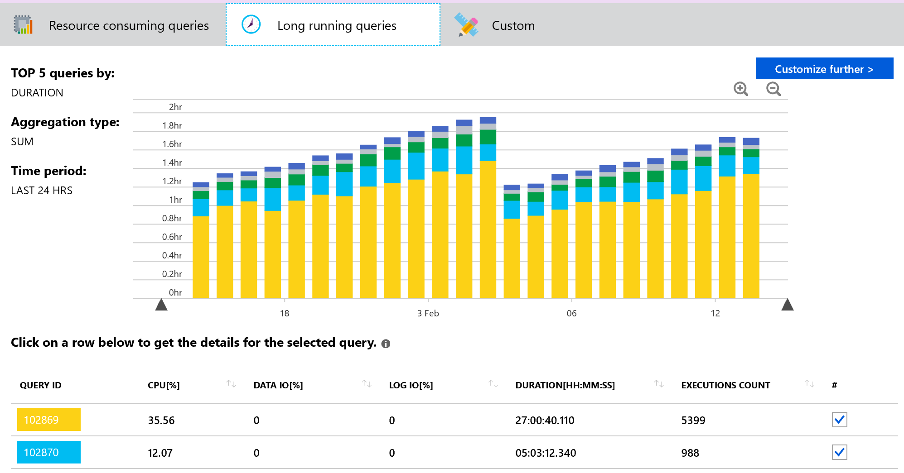
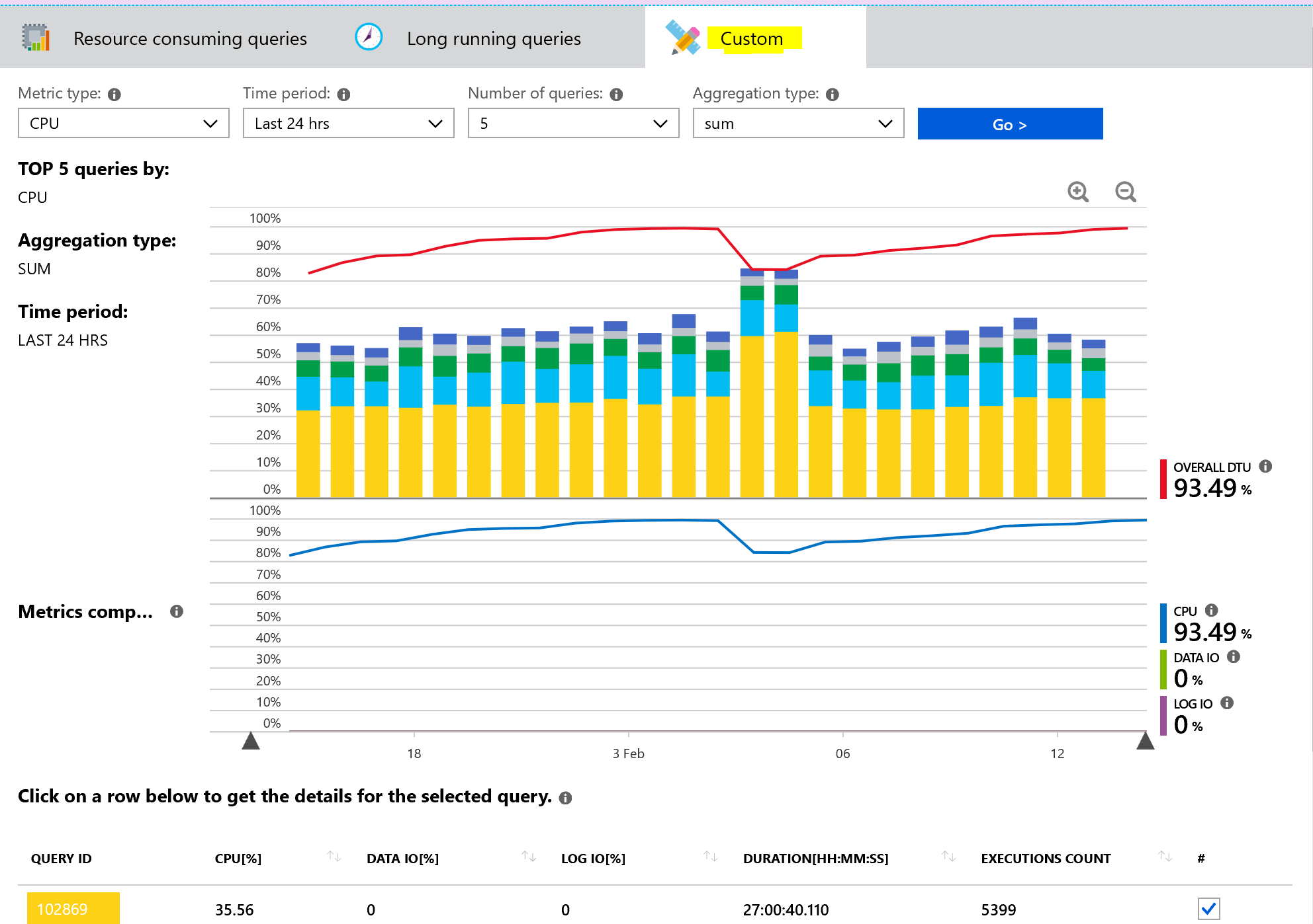
Query Performance Insight
Custom options – Insights based upon custom selection:
Metric Type – CPU , Data IO, Log IO, Duration and Execution Count.
Time Period – Last 6 hrs, Last 24 hrs, Past Week, Past Month and Custom.
Number of Queries – 5, 10, 20.
Aggregation type – sum, max and avg.
Query Performance Insight
Shows top performance degrading queries by showing most resource consuming queries, long running queries and custom configuration.
Can drill through the queries to see Query text, CPU, data IO and Log IO utilization %, Duration and Execution count.
Notes:
Managing and tuning the performance of relational databases is a challenging task that requires significant expertise and time investment. Query Performance Insight allows you to spend less time troubleshooting database performance by providing the following:+
Deeper insight into your databases resource (DTU) consumption.
The top queries by CPU/Duration/Execution count, which can potentially be tuned for improved performance.
The ability to drill down into the details of a query, view its text and history of resource utilization.
Performance tuning annotations that show actions performed by SQL Azure Database Advisor
Open Azure portal and find database that you want to examine.
From left-hand side menu, under support and troubleshooting, select “Query Performance Insight”.
On the first tab, review the list of top resource-consuming queries.
Select an individual query to view its details.
Open SQL Azure Database Advisor and check if any recommendations are available.
Use sliders or zoom icons to change observed interval.
The top line shows overall DTU% for the database, while the bars show CPU% consumed by the selected queries during the selected interval (for example, if Past week is selected each bar represents one day).
The bottom grid represents aggregated information for the visible queries.
Query ID - unique identifier of query inside database.
CPU per query during observable interval (depends on aggregation function).
Duration per query (depends on aggregation function).
Total number of executions for a particular query.

Slide 12
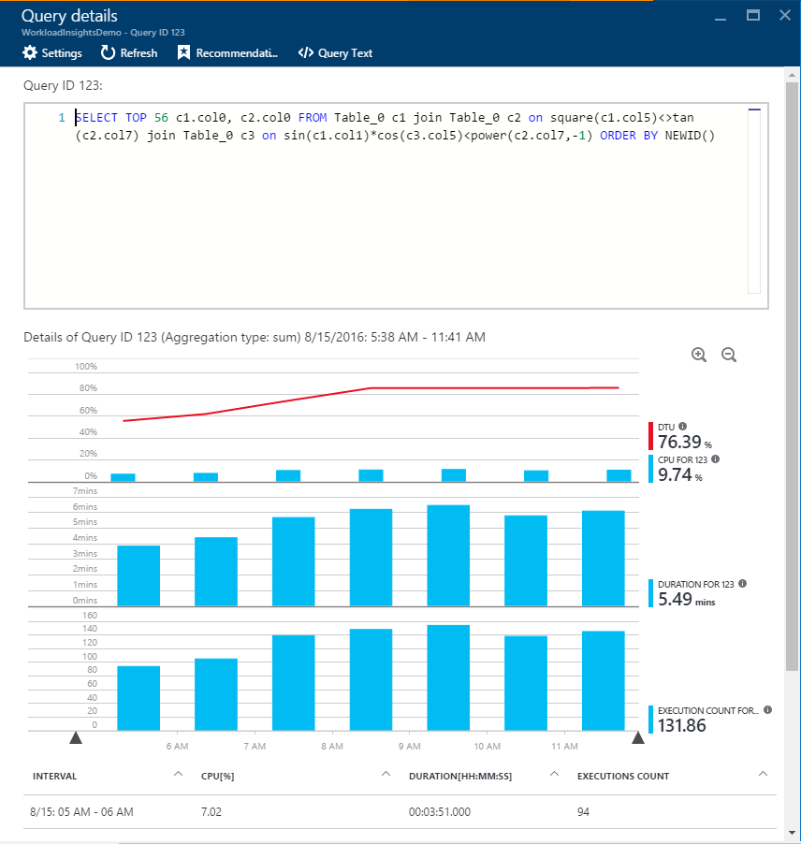
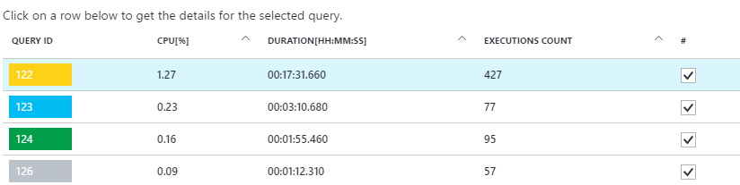
Viewing individual query details
Get details for the individual queries
CPU Consumption
Duration
Execution Count
It does not capture DDL queries
Notes:
Click any query in the list of top queries.
The details view opens and the queries CPU consumption/Duration/Execution count is broken down over time.
Click around the chart for details.
Top chart shows line with overall database DTU%, and the bars are CPU% consumed by the selected query.
Second chart shows total duration by the selected query.
Bottom chart shows total number of executions by the selected query.

Slide 13
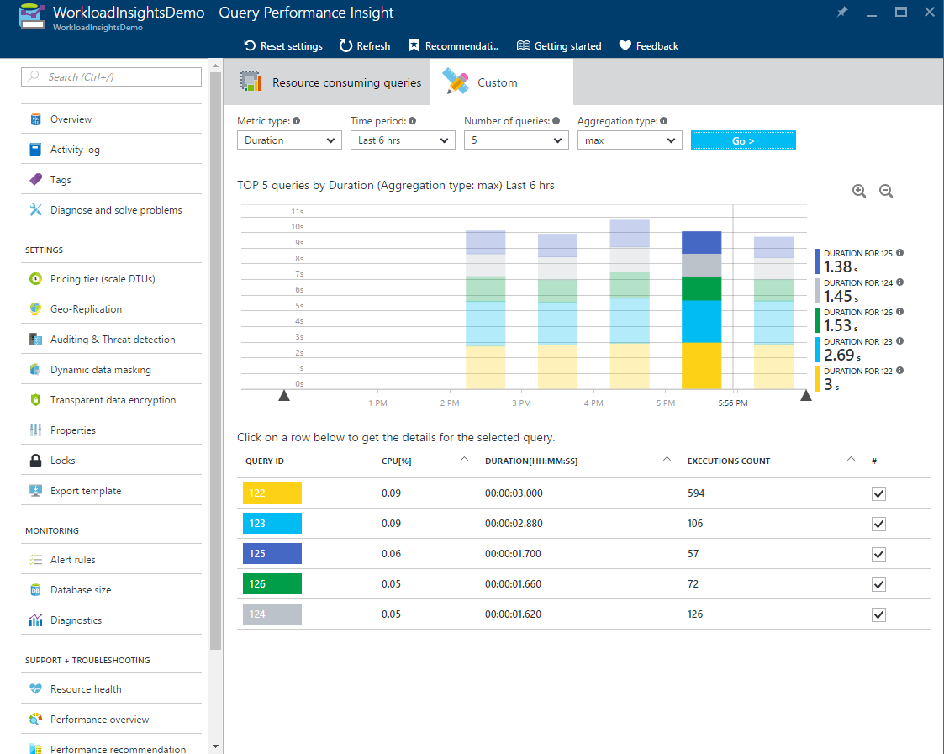
Review top queries per duration
Duration is one of the metrics showing potential bottleneck
Long-running queries has potential for:
Longer locks
Blocking other users
Limiting scalability
Notes:
In the recent update of Query Performance Insight, we introduced two new metrics that can help you identify potential bottlenecks: duration and execution count.
Long-running queries have the greatest potential for locking resources longer, blocking other users, and limiting scalability. They are also the best candidates for optimization.
Open Custom tab in Query Performance Insight for selected database
Change metrics to be duration

Slide 14
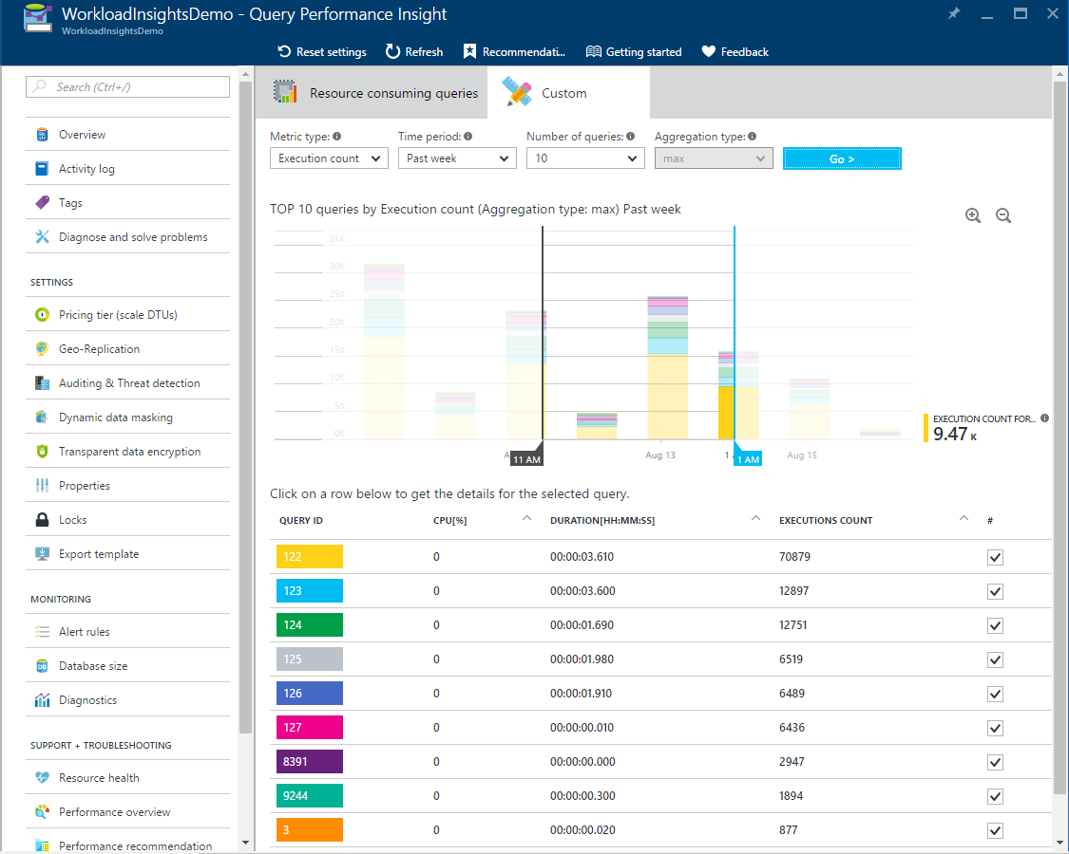
Review top queries per execution count
Execution count is one of the metrics showing potential bottleneck
High number og executions has potential for:
Database performance
Network latency
Downstream server latency
Notes:
High number of executions might not be affecting database itself and resources usage can be low, but overall application might get slow.+
In some cases, very high execution count may lead to increase of network round trips. Round trips significantly affect performance. They are subject to network latency and to downstream server latency.
For example, many data-driven Web sites heavily access the database for every user request. While connection pooling helps, the increased network traffic and processing load on the database server can adversely affect performance. General advice is to keep round trips to an absolute minimum.+
To identify frequently executed queries (“chatty”) queries:+
Open Custom tab in Query Performance Insight for selected database
Change metrics to be execution count

Slide 15
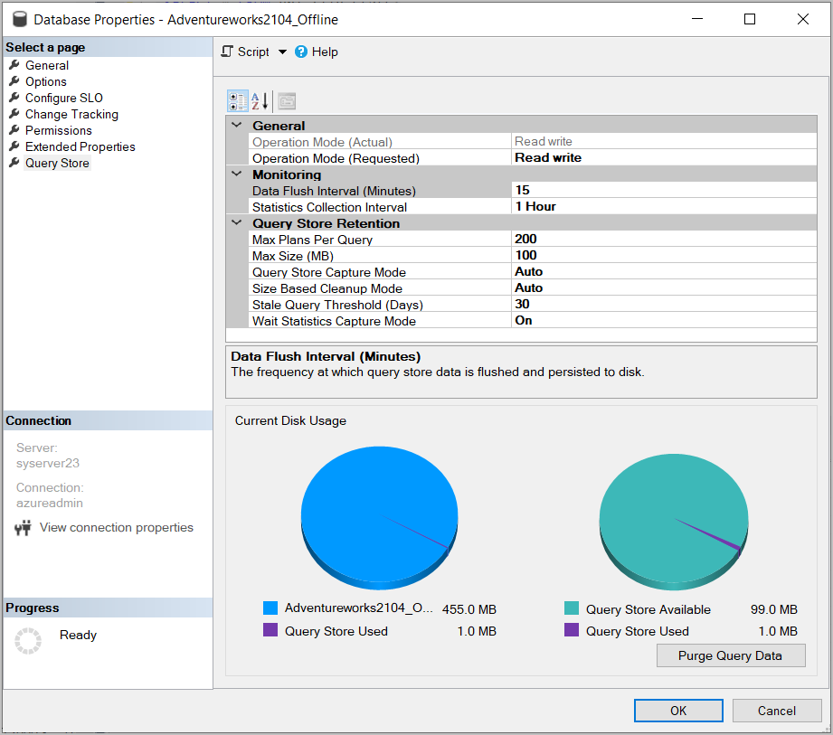
Query Store
Retention Policy
Size based – Auto cleanup when near max size.
Time based – Default 30 days.
Max Plans Per Query – Default 200.
Wait Statistics Capture Mode – Default On.
Capture Policy
All – Captures all queries.
Auto – Infrequent queries are ignored.
None – No queries are captured.
Custom – Advanced Options
Notes:
Recommended retention and capture policy
There are two types of retention policies:+
Size based - if set to AUTO it will clean data automatically when near max size is reached.
Time based - by default we will set it to 30 days, which means, if Query Store will run out of space, it will delete query information older than 30 days
Capture policy could be set to:
All - Captures all queries.
Auto - Infrequent queries and queries with insignificant compile and execution duration are ignored. Thresholds for execution count, compile and runtime duration are internally determined. This is the default option.
None - Query Store stops capturing new queries, however runtime stats for already captured queries are still collected.
We recommend setting all policies to AUTO and clean policy to 30 days

Slide 16

Demonstration
Query Performance Insight
Analyze the Query Performance Insight output.
Notes:
M05L02Demo01
Demo Requirements
Salesdb that was created in module 1
Use the script C:\Demos\M05L02Demo01\Workload.sql.
Make sure that you have already created and populated the table because this takes a few minutes to complete
SSMS
Steps:
Open your SSMS, connect to your logical server
Right click on the salesdb and select Properties → Query Store
Change the following settings:
Data Flush Interval → 1min
Statistics Collection Interval → 1 Minute
Click on “Purge Query Data” to empty the Query Store
Open the Workload.sql file and execute the stored procedure
EXEC dbo.proc_Emp_search 123
GO 20
EXEC dbo.proc_Emp_search 121023
GO 20
6. Create the non-clustered index and execute the stored procedure EXEC dbo.proc_Emp_search 123 again
7. Wait for 1 minute so that the query store can collect the execution times and the Query plans. You should see 2 query plans for the same query
8. Open the Azure Portal, go to the salesdb and click on Query Performance Insight
9. The query of the stored procedure should be available.
10. Show the dashboard of the resource consuming query and click on the query to drill down in more execution statistics of the query
11. Go back to the Object Explorer of SSMS → Query store → Top Resource Consuming Queries
12. Show the different option of the query store and also show that there are 2 different query plans for the same query.

Slide 17

Monitoring Query Performance using Query Performance Insights
Configure the Query Store.
Analyze the Query Performance Insight.
Notes:
M05L02Lab01

Slide 18
Questions?

Slide 19
Knowledge Check
What feature should be enabled on your Azure SQL Database before you can use Query Performance Insight?
How can you view individual query details?
Notes:
Question 1: What feature should be enabled on your Azure SQL Database before you can use Query Performance Insight?
Answer 1: The Query Store should be enabled on the database. This is enabled by default when you create a new database
Question 2: How can you view individual query details?
Answer 2: Click on the Query ID in the performance insight to verify the query details

Slide 20
Lesson 3: Azure SQL Database Tuning using Automatic Tuning
Notes:
This lesson covers the Azure SQL Database Tuning using Automatic Tuning

Slide 21
Objectives
After completing this learning, you will be able to:
Know how Performance Recommendations can help to improve database performance.
Notes:
This lesson covers the Azure SQL Database Tuning using Automatic Tuning

Slide 22
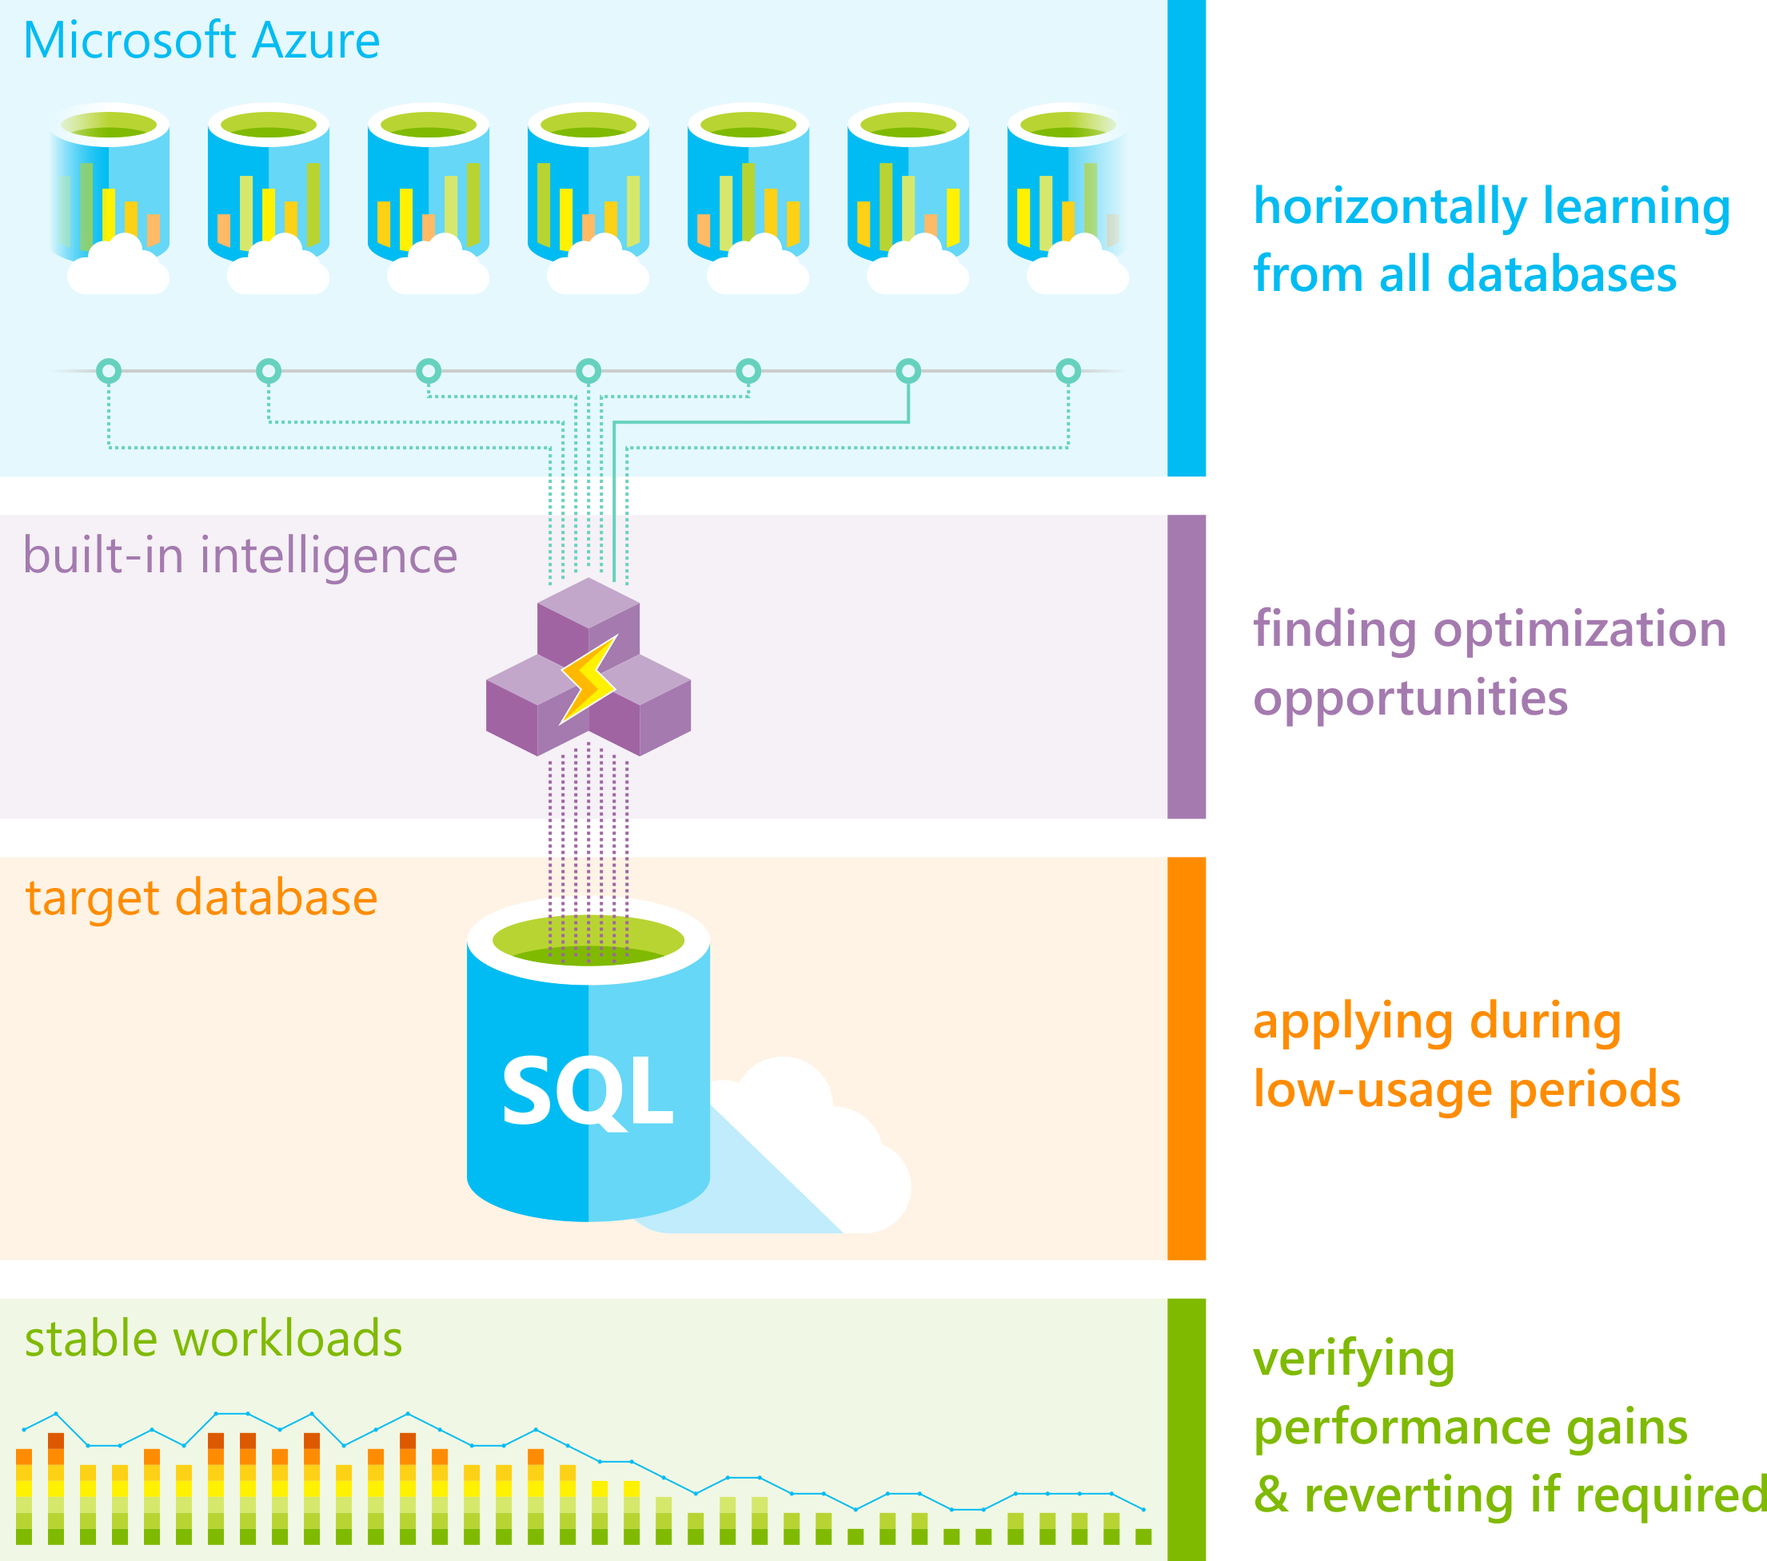
Automatic Tuning
Performance recommendations for SQL Database
Notes:
Azure SQL Database Automatic tuning provides peak performance and stable workloads through continuous performance tuning utilizing Artificial Intelligence.
Automatic tuning is a fully managed service that uses built-in intelligence to continuously monitor queries executed on a database and it automatically improves their performance. This is achieved through dynamically adapting database to the changing workloads and applying tuning recommendations. Automatic tuning learns horizontally from all databases on Azure through Artificial Intelligence and it dynamically improves its tuning actions. The longer an Azure SQL Database runs with automatic tuning on, the better it performs.
Azure SQL Database Automatic tuning might be one of the most important features that you can enable to provide stable and peak performing workloads.
Tuning operations applied to Azure SQL Databases are fully safe for the performance of your most intense workloads. The system has been designed with care not to interfere with the user workloads. Automated tuning recommendations are applied only at the times of a low utilization. The system can also temporarily disable automatic tuning operations to protect the workload performance. In such case, “Disabled by the system” message will be shown in Azure portal. Automatic tuning regards workloads with the highest resource priority.
Automatic tuning mechanisms are mature and have been perfected on hundreds of thousands of databases running on Azure. Automated tuning operations applied are verified automatically to ensure there is a positive improvement to the workload performance. Regressed performance recommendations are dynamically detected and promptly reverted. Through the tuning history log there is a clear trace of tuning improvements made to each Azure SQL Database.
Automatic tuning options available in Azure SQL Database are:
CREATE INDEX - identifies indexes that may improve performance of your workload, creates indexes, and automatically verifies that performance of queries has improved.
DROP INDEX - identifies redundant and duplicate indexes, and indexes that were not used for a very long period of time. Please note that this option is not compatible with applications using partition switching and index hints.
FORCE LAST GOOD PLAN - identifies SQL queries using execution plan that is slower than the previous good plan, and queries using the last known good plan instead of the regressed plan.

Slide 23
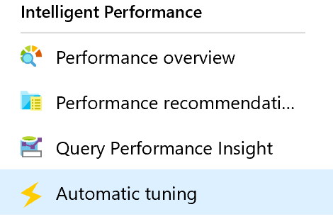
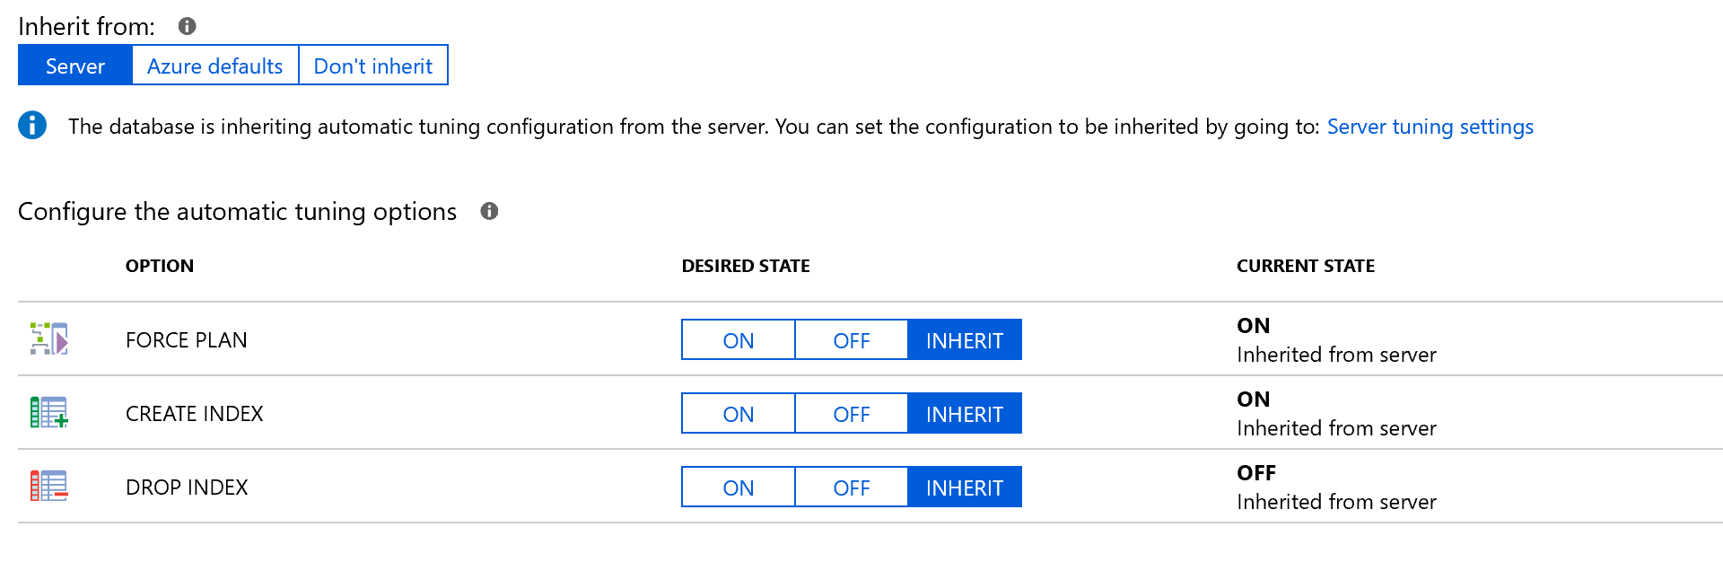
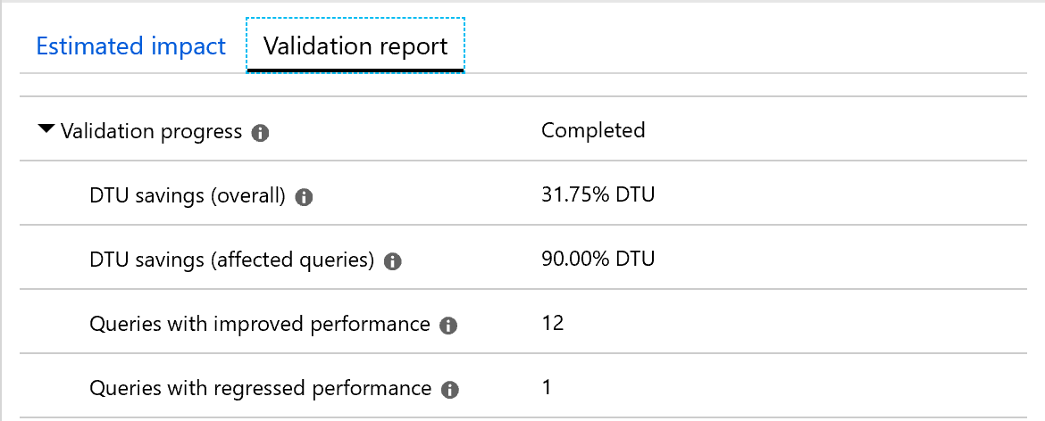
Intelligent Performance – Automatic Tuning
Force Last Good Plan:
Identifies and creates Indexes, validates performance improvements and reverts the change if performance degrades.
Drop Index:
Identifies and drops unused Indexes, validates performance improvements and reverts the change if performance degrades.
Identifies regressed queries due to bad plan and replaces the bad plan with last Good Plan, validates performance improvements and reverts the change if performance does not improve.
Create Index:
http://automaticplancorrectiondemo.azurewebsites.net/index.html

Slide 24
Automatic Tuning – Create Index
SQL Database monitors the queries
Identifies indexes that could improve performance
Creates an index recommendation (high, medium or low)
Apply the index recommendation
Compare the performance with the baseline
If performance improved?
Revert OR
Flagged as successful
Notes:
Create index recommendations
SQL Database continuously monitors the queries that are running and identifies the indexes that could improve performance. After there's enough confidence that a certain index is missing, a new Create index recommendation is created.
Azure SQL Database builds confidence by estimating the performance gain the index would bring through time. Depending on the estimated performance gain, recommendations are categorized as high, medium, or low.
Indexes that are created by using recommendations are always flagged as auto-created indexes. You can see which indexes are auto-created by looking at the sys.indexes view. Auto-created indexes don’t block ALTER/RENAME commands.
If you try to drop the column that has an auto-created index over it, the command passes. The auto-created index is dropped with the command as well. Regular indexes block the ALTER/RENAME command on columns that are indexed.
After the create index recommendation is applied, Azure SQL Database compares the performance of the queries with the baseline performance. If the new index improved performance, the recommendation is flagged as successful and the impact report is available. If the index didn’t improve performance, it's automatically reverted. SQL Database uses this process to ensure that recommendations improve database performance.
Any create index recommendation has a back-off policy that doesn't allow applying the recommendation if the resource usage of a database or pool is high. The back-off policy takes into account CPU, Data IO, Log IO, and available storage.
If CPU, Data IO, or Log IO is higher than 80% in the previous 30 minutes, the create index recommendation is postponed. If the available storage will be below 10% after the index is created, the recommendation goes into an error state. If, after a couple of days, automatic tuning still believes that the index would be beneficial, the process starts again.
This process repeats until there's enough available storage to create an index, or until the index isn't seen as beneficial anymore.

Slide 25
Automatic Tuning – Drop Index
Is an index not used
Drop index recommendation
Apply the index recommendation
Compare the performance with the baseline
If performance improved?
Revert OR
Flagged as successful
Notes:
Drop index recommendations
Besides detecting missing indexes, SQL Database continuously analyzes the performance of existing indexes. If an index is not used, Azure SQL Database recommends dropping it. Dropping an index is recommended in two cases:
The index is a duplicate of another index (same indexed and included column, partition schema, and filters).
The index hasn't been used for a prolonged period (93 days).
Drop index recommendations also go through the verification after implementation. If the performance improves, the impact report is available. If performance degrades, the recommendation is reverted.

Slide 26
Automatic Tuning – Parameterize Queries
Queries that are constantly being recompiled but end up with the same query execution plan
Forced parameterization
Apply the recommendation
Compare the performance with the baseline
If performance improved?
Revert OR
Flagged as successful
Notes:
Parameterize queries recommendations
Parameterize queries recommendations appear when you have one or more queries that are constantly being recompiled but end up with the same query execution plan. This condition creates an opportunity to apply forced parameterization. Forced parameterization, in turn, allows query plans to be cached and reused in the future, which improves performance and reduces resource usage.
Every query that's issued against SQL Server initially needs to be compiled to generate an execution plan. Each generated plan is added to the plan cache. Subsequent executions of the same query can reuse this plan from the cache, which eliminates the need for additional compilation.
Queries with non-parameterized values can lead to performance overhead because the execution plan is recompiled each time the non-parameterized values are different. In many cases, the same queries with different parameter values generate the same execution plans. These plans, however, are still separately added to the plan cache.
The process of recompiling execution plans uses database resources, increases the query duration time, and overflows the plan cache. These events, in turn, cause plans to be evicted from the cache. This SQL Server behavior can be altered by setting the forced parameterization option on the database.
To help you estimate the impact of this recommendation, you are provided with a comparison between the actual CPU usage and the projected CPU usage (as if the recommendation were applied). This recommendation can help you gain CPU savings. It can also help you decrease query duration and overhead for the plan cache, which means that more of the plans can stay in the cache and be reused. You can apply this recommendation quickly by selecting the Apply command.
After you apply this recommendation, it enables forced parameterization within minutes on your database. It starts the monitoring process, which lasts for approximately 24 hours. After this period, you can see the validation report. This report shows the CPU usage of your database 24 hours before and after the recommendation has been applied. SQL Database Advisor has a safety mechanism that automatically reverts the applied recommendation if performance regression has been detected.

Slide 27
Questions?

Slide 28
Knowledge Check
List three types of recommendations from Automatic Tuning.
What could be a reason to disable the automatic tuning option?
What technology is used for Automatic Tuning?
Notes:
Question 1:List three types of recommendations from SQL Database Advisor?
Answer 1: Create Index, Drop Index and Parameterize queries recommendations
Question 2: What could be a reason to disable the automatic tuning option?
Answer 2: You will lose index design control and it can even impact application performance.
Question 3: What technology is used for Automatic Tuning?
Answer 3: Automatic tuning learns horizontally from all databases on Azure through Artificial Intelligence and it dynamically improves its tuning actions. The longer an Azure SQL Database runs with automatic tuning on, the better it performs.

Slide 29
Lesson 4: Monitoring Azure SQL Database Performance using Intelligent Insights

Slide 30
Objectives
After completing this learning, you will be able to:
Use Intelligent Insights, to let you know what is happening with your database performance.

Slide 31
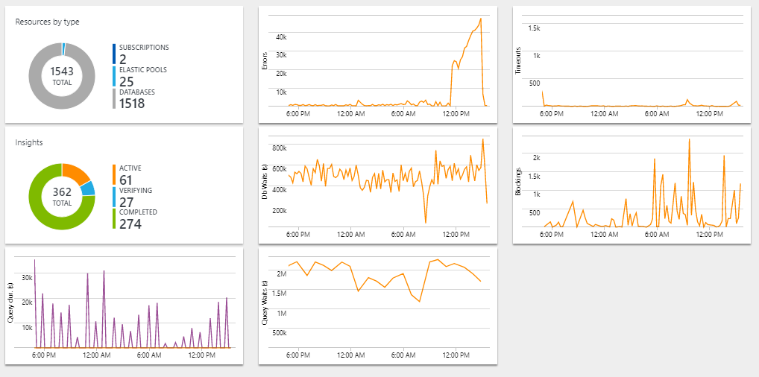
Monitoring Azure SQL Database Performance using Intelligent Insights
Monitoring Azure SQL Database at scale
Integrated with Operations Management Suite.
Monitor entire Azure SQL Database estate across multiple subscriptions.
Provides a view into raw telemetry.
Monitored activities
Resource usage
Query performance
SQL errors
Timeouts
Blocking
Intelligent insights
Notes:
Azure SQL Database Intelligent Insights lets you know what is happening with your database performance.
Intelligent Insights uses built-in intelligence to continuously monitor database usage through artificial intelligence and detect disruptive events that cause poor performance. Once detected, a detailed analysis is performed that generates a diagnostics log with an intelligent assessment of the issue. This assessment consists of a root cause analysis of the database performance issue and, where possible, recommendations for performance improvements.
What can Intelligent Insights do for you?
Intelligent Insights is a unique capability of Azure built-in intelligence that provides the following value:
Proactive monitoring
Tailored performance insights
Early detection of database performance degradation
Root cause analysis of issues detected
Performance improvement recommendations
Scale out capability on hundreds of thousands of databases
Positive impact to DevOps resources and the total cost of ownership

Slide 32
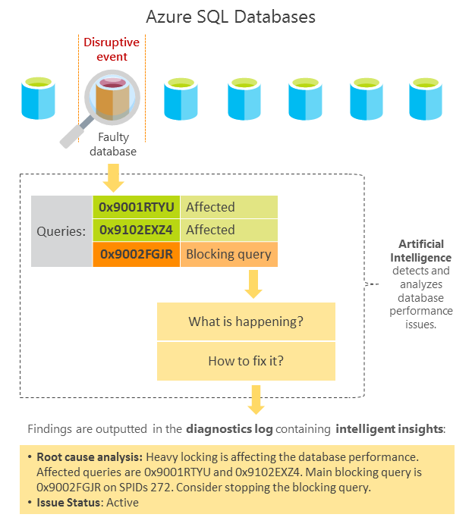
How does Intelligent Insights work?
Intelligent Insights analyzes SQL Database performance by comparing the database workload from the last hour with the past seven-day baseline workload.
After a performance degradation issue is detected from multiple observed metrics by using artificial intelligence, analysis is performed.
A diagnostics log is generated with an intelligent insight on what is happening with your database.
Each detected issue is tracked through its lifecycle from initial issue detection and verification of performance improvement to its completion.
Updates are provided in the diagnostics log every 15 minutes.
The metrics used to measure and detect database performance issues are based on query duration, timeout requests, excessive wait times, and errored requests.
Notes:
Intelligent Insights analyzes SQL Database performance by comparing the database workload from the last hour with the past seven-day baseline workload. Database workload is composed of queries determined to be the most significant to the database performance, such as the most repeated and largest queries. Because each database is unique based on its structure, data, usage, and application, each workload baseline that is generated is specific and unique to an individual instance. Intelligent Insights, independent of the workload baseline, also monitors absolute operational thresholds and detects issues with excessive wait times, critical exceptions, and issues with query parameterizations that might affect performance.
After a performance degradation issue is detected from multiple observed metrics by using artificial intelligence, analysis is performed. A diagnostics log is generated with an intelligent insight on what is happening with your database. Intelligent Insights makes it easy to track the database performance issue from its first appearance until resolution. Each detected issue is tracked through its lifecycle from initial issue detection and verification of performance improvement to its completion. Updates are provided in the diagnostics log every 15 minutes.
The metrics used to measure and detect database performance issues are based on query duration, timeout requests, excessive wait times, and errored requests.
Identified SQL Database performance degradations are recorded in the diagnostics log
Performance issues that are recorded in the diagnostics log are flagged with one of the three states of an issue lifecycle: "Active", "Verifying", and "Complete". After a performance issue is detected, and as long it's deemed as present by SQL Database built-in intelligence, the issue is flagged as "Active". When the issue is considered mitigated, it's verified and the issue status is changed to "Verifying". After SQL Database built-in intelligence considers the issue resolved, the issue status is flagged as "Complete".

Slide 33
Performance Troubleshooting
Detectable performance patterns | Details outputted
Reaching resource limits | Consumption of available resources (DTUs), database worker threads, or database login sessions available on the monitored subscription has reached limits, which causes SQL Database performance issues.
Workload Increase | Workload increase or continuous accumulation of workload on the database was detected, which causes SQL Database performance issues.
Memory Pressure | Workers that requested memory grants have to wait for memory allocations for statistically significant amounts of time. Or an increased accumulation of workers that requested memory grants exists, which affects SQL Database performance.
Locking | Excessive database locking was detected, which affects SQL Database performance.
Increased MAXDOP | The maximum degree of parallelism option (MAXDOP) has changed, and it affects the query execution efficiency.
Pagelatch Contention | Pagelatch contention was detected, which affects SQL Database performance. Multiple threads concurrently attempt to access the same in-memory data buffer pages. This results in increased wait times, which affects SQL Database performance.
Missing Index | A missing index issue was detected, which affects SQL Database performance.
Notes:
Detailed information on each performance issue can be found on https://docs.microsoft.com/en-us/azure/sql-database/sql-database-intelligent-insights-troubleshoot-performance
Detectable database performance patterns
Intelligent Insights automatically detects performance issues with SQL Database based on query execution wait times, errors, or time-outs. It then outputs detected performance patterns to the diagnostics log. Detectable performance patterns are summarized in the following table:
Reaching resource limits
Consumption of available resources (DTUs), database worker threads, or database login sessions available on the monitored subscription has reached limits, which causes SQL Database performance issues.
Workload Increase
Workload increase or continuous accumulation of workload on the database was detected, which causes SQL Database performance issues.
Memory Pressure
Workers that requested memory grants have to wait for memory allocations for statistically significant amounts of time. Or an increased accumulation of workers that requested memory grants exists, which affects SQL Database performance.
Locking
Excessive database locking was detected, which affects SQL Database performance.
Increased MAXDOP
The maximum degree of parallelism option (MAXDOP) has changed, and it affects the query execution efficiency.
Pagelatch Contention
Pagelatch contention was detected, which affects SQL Database performance. Multiple threads concurrently attempt to access the same in-memory data buffer pages. This results in increased wait times, which affects SQL Database performance.
Missing Index
A missing index issue was detected, which affects SQL Database performance.

Slide 34
Performance Troubleshooting (continued)
Detectable performance patterns | Details outputted
New Query | A new query was detected, which affects overall SQL Database performance.
Unusual Wait Statistic | Unusual database wait times were detected, which affects SQL Database performance.
TempDB Contention | Multiple threads try to access the same tempDB resources, which causes a bottleneck that affects SQL Database performance.
Elastic Pool DTU Shortage | A shortage of available eDTUs in the elastic pool affects SQL Database performance.
Plan Regression | A new plan or a change in the workload of an existing plan was detected, which affects SQL Database performance.
Database-Scoped Configuration Value Change | A configuration change on the database affects SQL Database performance.
Slow Client | A slow application client unable to consume output from the SQL Database fast enough was detected, which affects SQL Database performance.
Pricing Tier Downgrade | A pricing tier downgrade action decreased available resources, which affects SQL Database performance.
Notes:
New Query
A new query was detected, which affects overall SQL Database performance.
Unusual Wait Statistic
Unusual database wait times were detected, which affects SQL Database performance.
TempDB Contention
Multiple threads try to access the same tempDB resources, which causes a bottleneck that affects SQL Database performance.
Elastic Pool DTU Shortage
A shortage of available eDTUs in the elastic pool affects SQL Database performance.
Plan Regression
A new plan or a change in the workload of an existing plan was detected, which affects SQL Database performance.
Database-Scoped Configuration Value Change
A configuration change on the database affects SQL Database performance.
Slow Client
A slow application client that is unable to consume output from the SQL Database fast enough was detected, which affects SQL Database performance.
Pricing Tier Downgrade
A pricing tier downgrade action decreased available resources, which affects SQL Database performance.

Slide 35
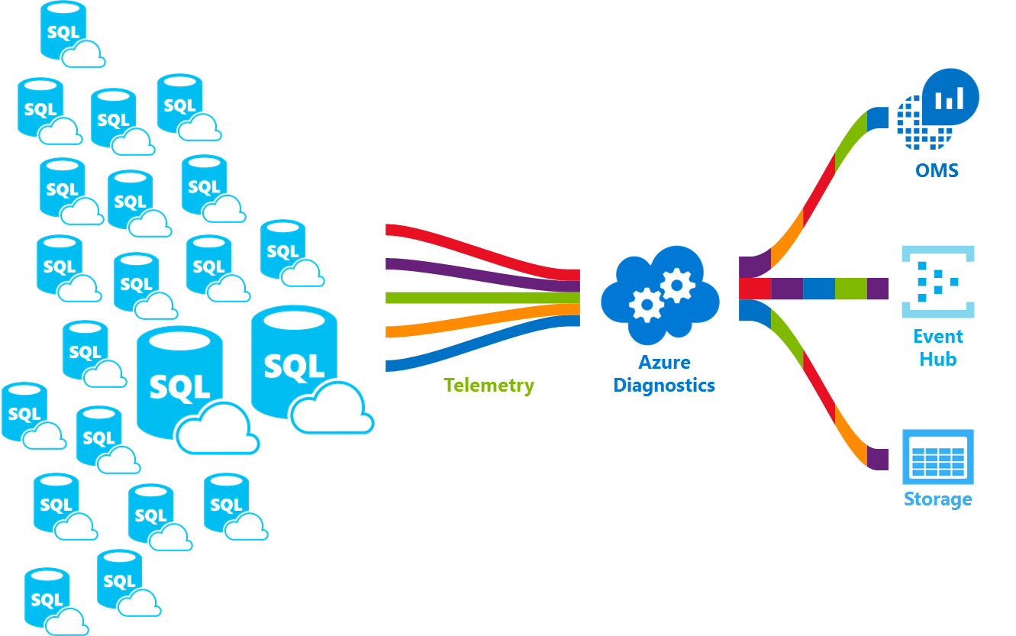
Use Intelligent Insights
Azure Log Analytics
Used to view the insights through a web browser.
Azure Event Hubs
Used to configure custom monitoring and alerting scenarios.
Azure Storage
Used for custom application development, such as for example custom reporting, or perhaps data archiving and retrieval.
Notes:
Intelligent Insights is a smart performance diagnostics log. It can be integrated with other products for consumption and specific applications such are Azure Log Analytics, Azure Event Hubs and Azure storage, or a third party products.
Intelligent Insights along with Azure Log Analytics is typically used to view the insights through a web browser and perhaps one of the easiest ways to get off the ground with using the product. Intelligent Insights along with Azure Event Hubs is typically used to configure custom monitoring and alerting scenarios. Intelligent insights along with Azure storage is typically used for custom application development, such is for example custom reporting, or perhaps data archiving and retrieval.
Integration of Intelligent Insights with other products Azure Log Analytics, Azure Event Hub, Azure storage, or third party products for consumption is performed through first enabling Intelligent Insights logging (SQLInsights log) and then configuring Intelligent Insights log data to be streamed into one of these products. For more information on how to enable Intelligent Insights logging and to configure log data to be streamed to a consuming product, see Azure SQL Database metrics and diagnostics logging.

Slide 36
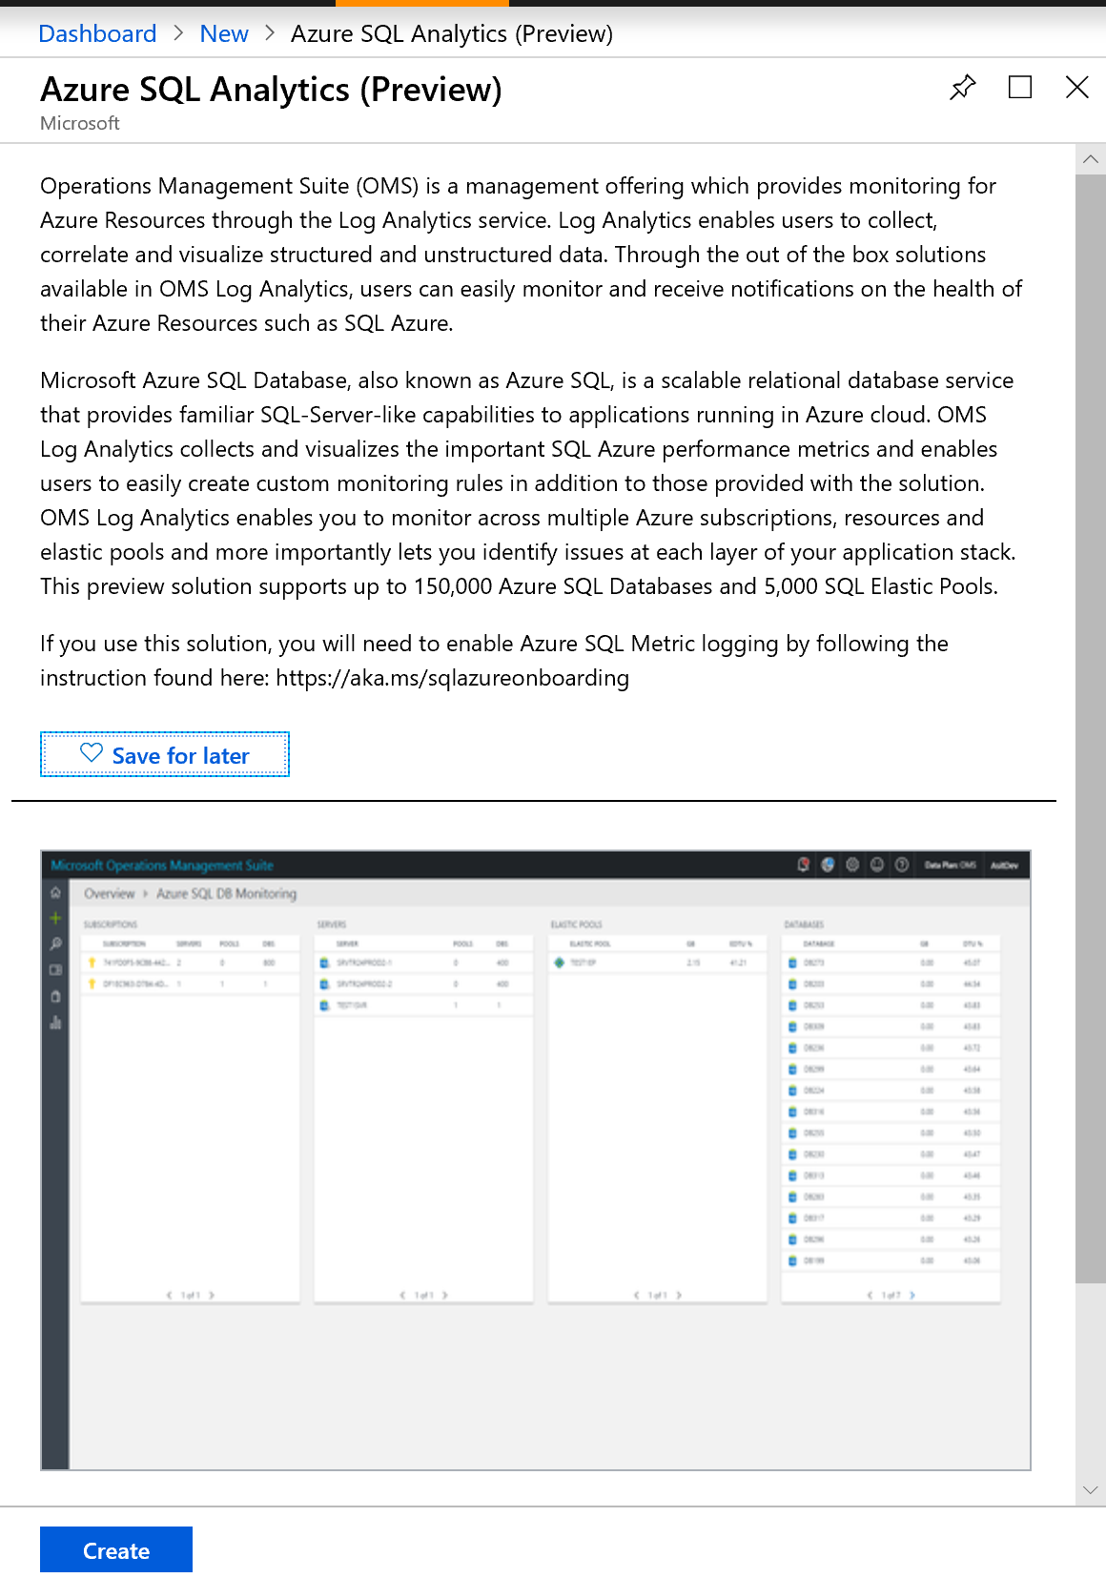
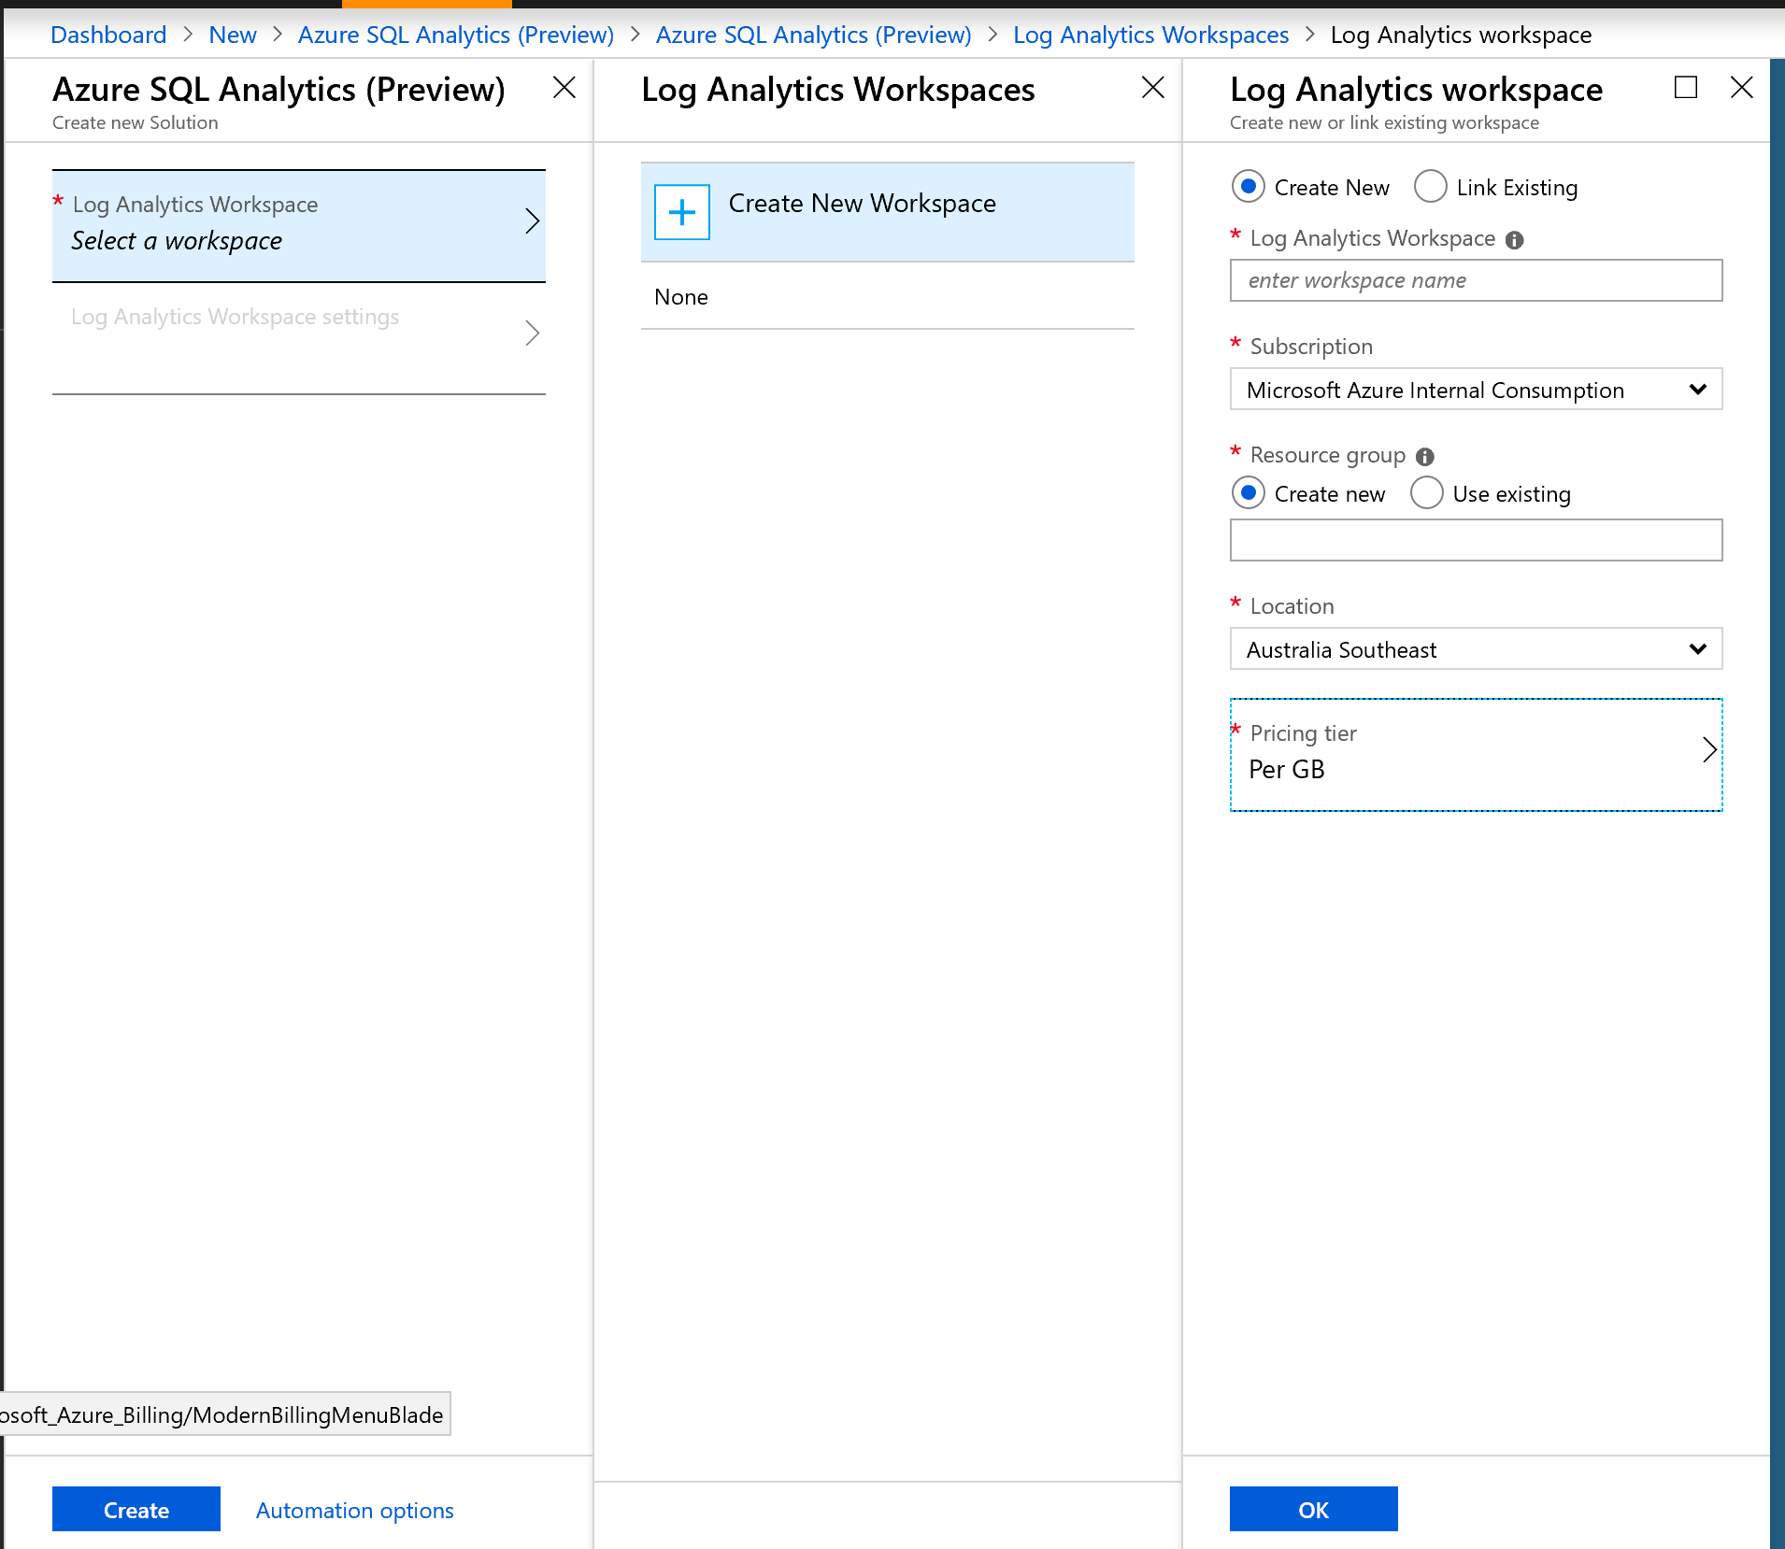
Azure SQL Analytics
Monitors performance at scale and across multiple subscriptions.
Visualizes performance metrics of Azure SQL DB Singletons, shared pools and Managed Instances.

Slide 37
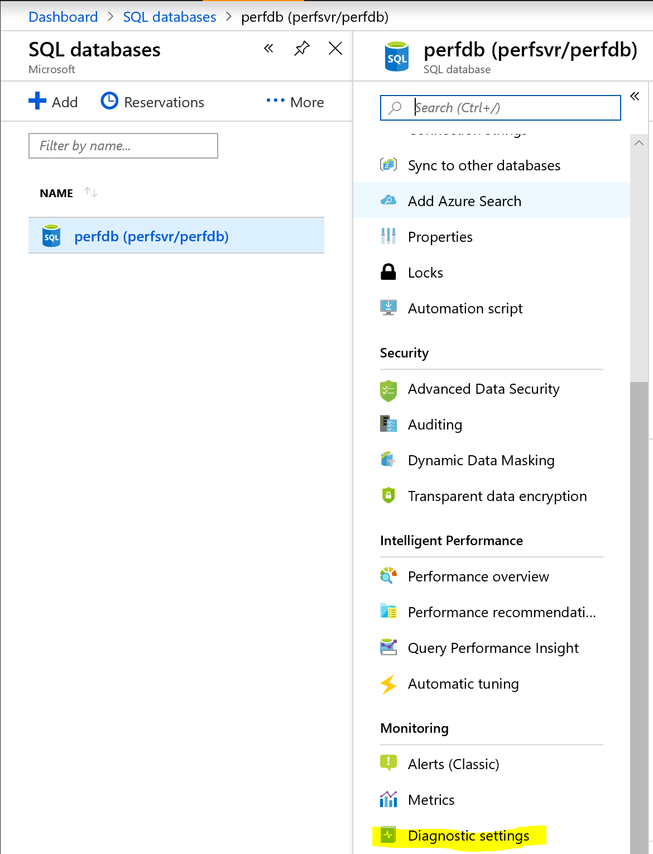
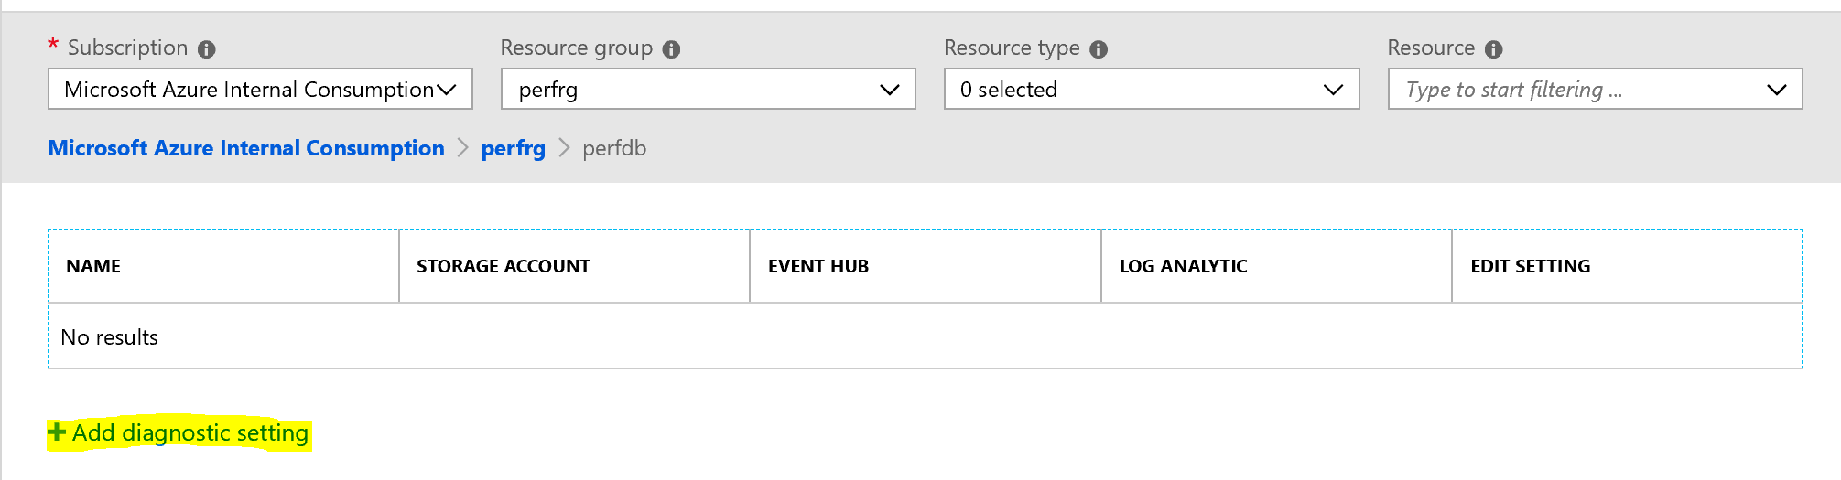
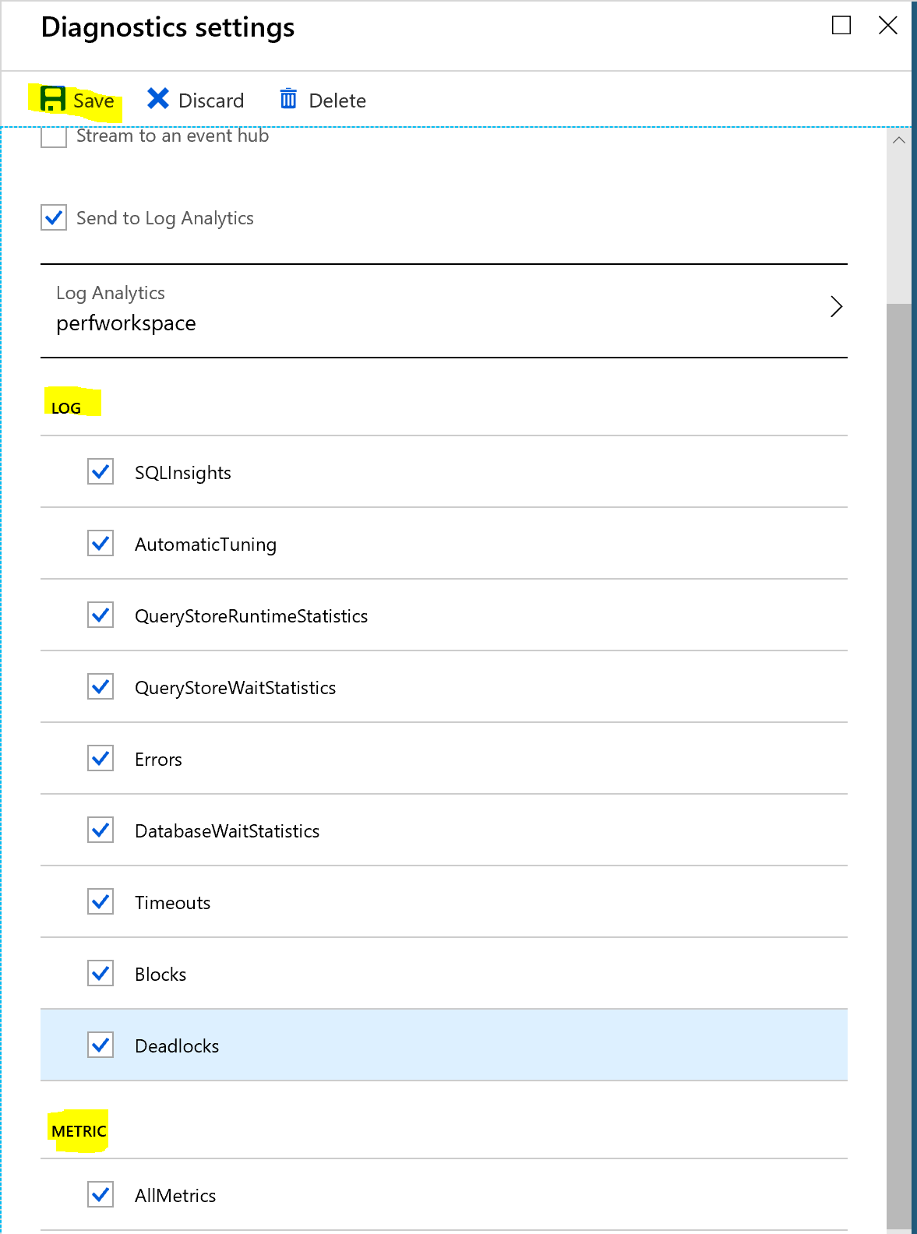
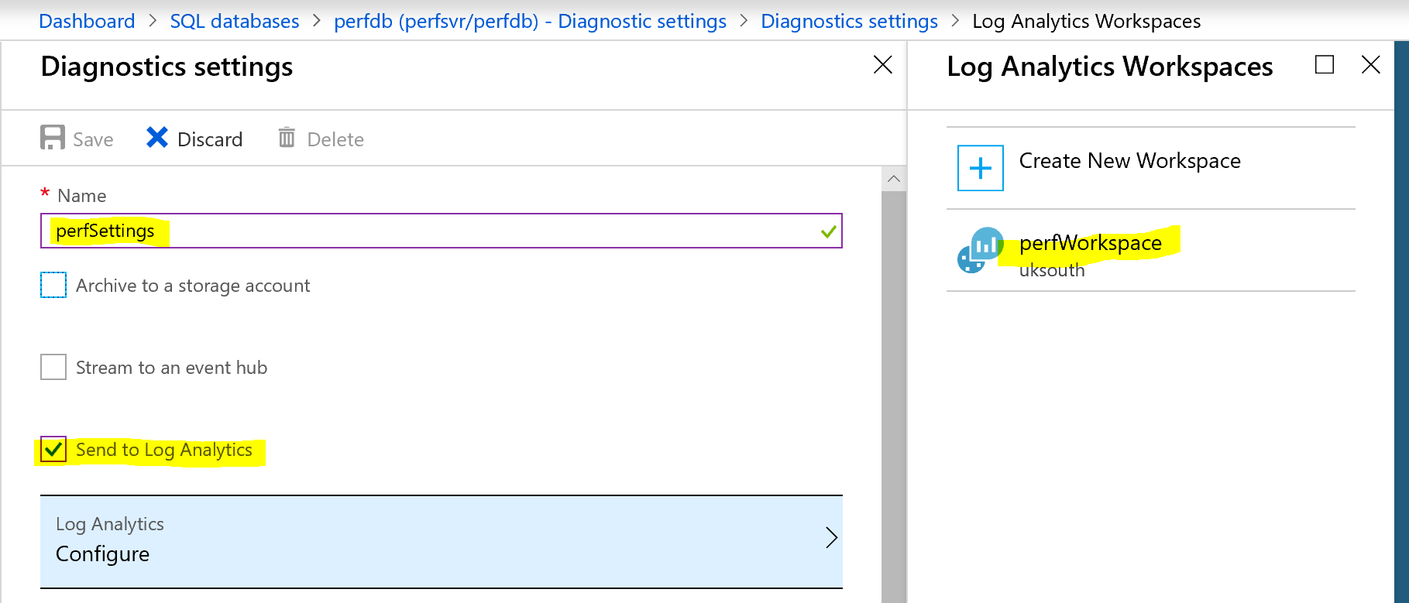
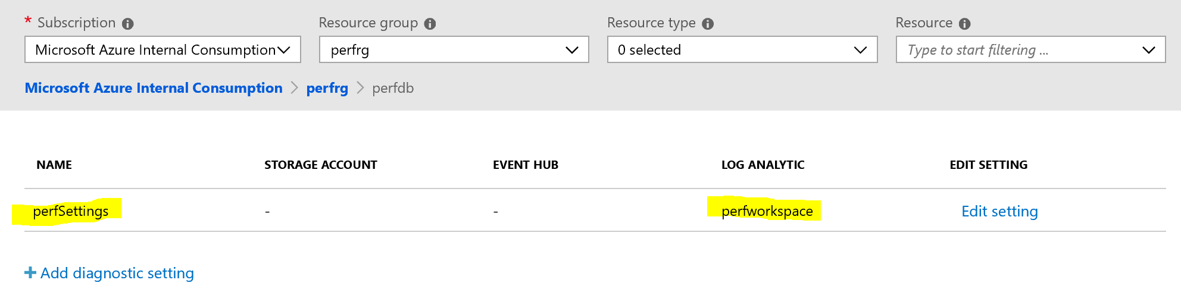
Configure Diagnostics

Slide 38
Demonstration
Intelligent Insight
Azure SQL Database metrics and diagnostics logging stream into Log Analytics.
Notes:
M05L04Demo01
Demo Requirements
Salesdb that has been created in module 1
Create a Log Analytics resource
Select Create a resource in the menu on the left.
Select IT & Management Tools.
Select Log Analytics.
Fill in the Log Analytics form with the additional information that is required:
workspace name, use a unique name
Subscription
resource group, use the same resource group as your logical server
Location – select the closest region
pricing tier – select free
Click on OK and wait until the deployment is finished
Configure databases to record metrics and diagnostics logs
To enable metrics and diagnostics logs collection in the portal, go to your SQL Database or elastic pool page, and then select Diagnostics settings.
Click on “Turn on Diagnostics”
Specify the following settings:
Name
Send to Log Analytics. Click on Log Analytics and select the OMS Workspace that you just created in step 1
Select all the Log & Metrics
Click Save
Install the SQL Analytics solution from the gallery
After you create the Log Analytics resource and your data is flowing into it, install the SQL Analytics solution.
In the Azure Portal, go to the Log Analytics that you have just created.
In the overview tab, click on “View Solutions”
Click on the Add button and search in the Management Solutions for “Azure SQL Analytics (Preview)”
Click on the solutions and click “Create”
Wait until the resource is created
Important: At the time I created this demo, I got the error --!!! This resource is unavailable, please try again later. --!!! After waiting a long time (hours) the resource came available… Apparently the SLA for Log analytics is 15min to 6 hours… https://azure.microsoft.com/en-in/support/legal/sla/log-analytics/v1_1/
Viewing Azure SQL Analytics data
Click on the Azure SQL Analytics tile to open the Azure SQL Analytics dashboard. The dashboard includes the overview of all databases that are monitored through different perspectives. For different perspectives to work, you must enable proper metrics or logs on your SQL resources to be streamed to Azure Log Analytics workspace.
Selecting any of the tiles, opens a drill-down report into the specific perspective. Once the perspective is selected, the drill-down report is opened.
REMARK: Be aware that you will not be able to show much of the SQL Analytics data since there are no queries or issues on you database.

Slide 39
Questions?

Slide 40
Knowledge Check
List three Azure resources that can be used to stream the Diagnostic Logs.
What are the three possible states of a performance issue that is logged?
What are the metrics that are used for detection models?
Notes:
Question 1: List three Azure resources that can be used to stream the Diagnostic Logs?
Answer 1: Azure Storage: Used for archiving vast amounts of telemetry for a small price.
Azure Event Hubs: Used for integrating SQL Database telemetry with your custom monitoring solution or hot pipelines.
Azure Log Analytics: Used for an out-of-the-box monitoring solution with reporting, alerting, and mitigating capabilities. This is a feature of the Operations Management Suite (OMS)
Question 2: What are the three possible states of a performance issue that is logged?
Answer 2: Performance issues that are recorded in the diagnostics log are flagged with one of the three states of an issue lifecycle: "Active", "Verifying", and "Complete". After a performance issue is detected, and as long it's deemed as present by SQL Database built-in intelligence, the issue is flagged as "Active". When the issue is considered mitigated, it's verified and the issue status is changed to "Verifying". After SQL Database built-in intelligence considers the issue resolved, the issue status is flagged as "Complete".
Question 3: What are the metrics that are used for detection models?
Answer 3: Metrics used for detection models that generate Intelligent Insights are based on monitoring:
Query duration
Timeout requests
Excessive wait time
Errored out requests

Slide 41
Lesson 5: Monitoring Azure SQL Database Performance using Extended Events

Slide 42
Objectives
After completing this learning, you will be able to:
Use extended events for troubleshooting performance issues.

Slide 43
Why XEvent?
SQLTrace and SQLProfiler are deprecated
Faster and scalable
Designed not to cause server problems
More events than SQLTrace ever had
Targets and actions make it powerful
SSMS includes the basic UI tooling
Notes:
Restrictions
There are a couple of security-related differences befitting the cloud environment of SQL Database:+
Extended events are founded on the single-tenant isolation model. An event session in one database cannot access data or events from another database.
You cannot issue a CREATE EVENT SESSION statement in the context of the master database.

Slide 44
XEvents Objects Explained
Event
Predefined instrumentation points in the code.
Actions
Event independent data to add to the collection.
For example: sql_text, create_dump_all_threads
Predicates
Independent fields for filtering.
For example: database_id, session_id
Targets
Ring Buffer, Event Counter, Event File
Maps
Maps “codes” to meaningful names.
For example: wait_type
Notes:
https://docs.microsoft.com/en-us/azure/sql-database/sql-database-xevent-db-diff-from-svr
Targets: Ring Buffer target - Briefly holds event data in memory.
Event Counter target - Counts all events that occur during an extended events session.
Event File target - Writes complete buffers to an Azure Storage container.

Slide 45
XEvents Usage Scenarios
Slow Query Performance
High Waits
Blocking
Deadlocks
High CPU
Notes:
Avoid expensive
Events e.g. showplan
Actions e.g. callstack
Filters on text columns

Slide 46
How to enable Extended Events
Setup a storage account and container.
Enable access to storage from SQL Database.
Collect Data using Extended Events.

Slide 47
Storage Container Authorizations
You need to create a Shared Acces Signature on the Storage account.
It provides delegated access to resources in your storage account.
Grant client's access to resources in your storage account, without sharing your account keys.
For Xevents you need to Read, Write & List permissions.
Use Azure Storage Explorer or Azure Portal to create SAS Token.

Slide 48
Collect Data Using Extended Events
Create a master key specifying a strong password
CREATE MASTER KEY ENCRYPTION BY PASSWORD = 'xxxxxx!';
Define the blob storage where the XEL will be saved. Use the SAS key that was provided by the definition of the blob storage
CREATE DATABASE SCOPED CREDENTIAL [https://xxxx.blob.core.windows.net/xe-container] WITH IDENTITY='SHARED ACCESS SIGNATURE', SECRET = 'sv=2014-02-14&sr=c&sig=Hz2n9vs%3D&st=2016-01-25T23%3A00%3A00Z&se=2016-02-02T23%3A00%3A00Z&sp=rw'
Define the Extended Event
Start the event and wait to reproduce the issue.
Once the issue has been reproduced, stop the event.
You should see XEL files in the storage container in Azure Storage Explorer.
You can then download to your laptop/local machine.
Notes:
Before you can create an extended event you have to make sure that database master key exists. To create a master key execute the following statement. Make sure that you provide a difficult password.
CREATE MASTER KEY ENCRYPTION BY PASSWORD = '<DifficultPassword>';
Once the container and the SAS token are created, you’ll need to create a database scoped credential in the database in order to save the events into a file.
Once the storage is setup correctly, you’ll need to configure the Extended Event. Here you’ll need to define which events you want to trace.
Once the trace is captured, you need to download the files to open them in the SQL Server Management Studio. The best option to download these files is with the Azure Portal or the Azure Storage Explorer.

Slide 49
Demonstration
Extended Events
Create Extended Events session using SSMS.
View Extended Events session.
Notes:
M05L05Demo01
Demo Requirement
The database that you have created in module 1
SSMS
Use the C:\Demos\M05L05Demo0\Create Storage Account.ps1 PowerShell script to create a new storage account, container and SAS Token.
Run the script before the demo and Make sure you save the SAS token because you need it to create the database credential.
Use the C:\Demos\M05L05Demo0\Xevents.sql SQL Script .
Steps – follow the steps in the xevents.sql script
Create MASTER KEY, use step 1 of the Xevents.SQL script
Create database scoped credential
Create event session
Start the event session
Simulate a query
Stop the event session
Show the results

Slide 50
Monitoring Azure SQL Database Performance using Extended Events
Exercise 1: Monitor Azure SQL Database using Extended Events.
Notes:
M05L05Lab01

Slide 51
Questions?

Slide 52
Knowledge Check
List three targets for extended events output.
List three problematic scenarios where extended events can help.
Notes:
Q: List three targets for extended events output.
A: Ring Buffer, Event counter, Event file target in Azure storage
Q:List three problematic scenarios where extended events can help.
A: Slow Query Performance, Deadlocks and blocking

Slide 53
Lesson 6: Configure Alerts through Azure Portal

Slide 54
Objectives
After completing this learning, you will be able to:
Configure alerts using Azure Management Portal.

Slide 55
Purpose of Alerts for Azure SQL Database
Database alerts can help to proactively trigger various events related to database connectivity, high DTU usage or deadlocks, etc.
It helps to proactively resolve underlying issues to avoid application outages and improve user experience.
Notes:
Classic alerts are deprecated but at the time of creating this slide, the metric option for Azure SQL Database was not yet available in Alerts.
We are working to support for SQL DB metrics with new alerts (by March 2019). You can continue using classic alerts for SQL DB until new metric alerts are supported. Please note that classic metric alerts are still fully supported until June 2019.
Note 1: We will allow creating one alert rule to manage multiple databases when we support alerts on sql.
Note 2: We plan to migrate existing SQL DB alerts to the new Monitor system automatically on customers behalf.

Slide 56
Receiving an alert based on monitoring metrics or events on
Metric values
The alert triggers when the value of a specified metric crosses a threshold you assigned in either direction. It triggers when the condition is first met and then when that condition is no longer being met.
Activity log events
An alert can trigger on every event, or, only when a certain number of events occur.
Notes:
Classic alerts are deprecated but at the time of creating this slide, the metric option for Azure SQL Database was not yet available in Alerts.
We are working to support for SQL DB metrics with new alerts (by March 2019). You can continue using classic alerts for SQL DB until new metric alerts are supported. Please note that classic metric alerts are still fully supported until June 2019.
Note 1: We will allow creating one alert rule to manage multiple databases when we support alerts on sql.
Note 2: We plan to migrate existing SQL DB alerts to the new Monitor system automatically on customers behalf.

Slide 57
Purpose of Alerts for Azure SQL Database
You can configure an alert to do the following when it triggers:
Send email notifications to the service administrator and co-administrators.
Send email to additional emails that you specify.
Call a webhook
You can configure and get information about alert rules using
Azure portal
PowerShell
command-line interface (CLI).
Azure Monitor REST API.
Notes:
Classic alerts are deprecated but at the time of creating this slide, the metric option for Azure SQL Database was not yet available in Alerts.
We are working to support for SQL DB metrics with new alerts (by March 2019). You can continue using classic alerts for SQL DB until new metric alerts are supported. Please note that classic metric alerts are still fully supported until June 2019.
Note 1: We will allow creating one alert rule to manage multiple databases when we support alerts on sql.
Note 2: We plan to migrate existing SQL DB alerts to the new Monitor system automatically on customers behalf.

Slide 58
SQL Database alert values
Metric Name | Aggregation Type | Minimum Alert Time Window
CPU percentage | Average | 5 minutes
Data IO percentage | Average | 5 minutes
Log IO percentage | Average | 5 minutes
DTU percentage | Average | 5 minutes
Total database size | Maximum | 30 minutes
Successful Connections | Total | 10 minutes
Failed Connections | Total | 10 minutes
Blocked by Firewall | Total | 10 minutes
Deadlocks | Total | 10 minutes
Database size percentage | Maximum | 30 minutes
In-Memory OLTP storage percent(Preview) | Average | 5 minutes
Workers percentage | Average | 5 minutes
Sessions percent | Average | 5 minutes
DTU limit | Average | 5 minutes
DTU used | Average | 5 minutes
Notes:
https://docs.microsoft.com/en-us/azure/sql-database/sql-database-insights-alerts-portal

Slide 59
Demonstration
Configure Alerts through Azure Portal
Configure alerts through Azure Portal.
Notes:
M05L06Demo01
Demo Requirements
The salesdb that was created in module 1
Create an alert rule on a metric with the Azure portal
Open the Azure Portal and go to your database
Select Alerts or Alert rules under the MONITORING section. The text and icon may vary slightly for different resources.
Select the Add alert command and fill in the fields.
Select Add under Condition and choose the Metric you want to monitor, then choose a Threshold value for the metric. Also choose the Period of time that the metric rule must be satisfied before the alert triggers. So for example, if you use the period "PT5M" and your alert looks for CPU above 80%, the alert triggers when the average CPU has been above 80% for 5 minutes. Once the first trigger occurs, it again triggers when the average CPU is below 80% over 5 minutes. The CPU measurement occurs every 1 minute.
Click Done
Click on the Select Action Group under the “Action Group”. Click on the Create action group. Enter a group name (Azure Admins) and short name (SQL Alerts) and select a Resource Group.
Give the Action name (Email Admins). Select Email/SMS/Push/Voice for the Action Type. Select the Email check box and enter your email address. Click Ok. Click Ok on the Add Action Group tab.
It’s good to describe some of the options for the Action Type, especially the Run Book Option. This is how we can automatically scale the DB up when CPU gets high (or the inverse).
Name your alert rule, and set a Description, which also shows in notification emails.
Within a few minutes, the alert is active and triggers as previously described.

Slide 60
Questions?

Slide 61
Module Summary
Monitoring and Troubleshooting Azure SQL Database
Monitoring Query Performance using Query Performance Insight
Azure SQL Database Tuning using Automatic Tuning
Monitoring Azure SQL Database Performance using Intelligent Insights
Monitoring Azure SQL Database Performance using Extended Events
Configure Alerts through Azure Portal

